Slide 1
INSTANT ASSURED
DELIVERY
FOR CRITICAL TRANSACTIONS

Slide 2
About Us
Founded in 2003, ValueFirst is a B2B company connecting enterprises to consumers, enabling
intelligent conversations across channels through various communication platforms.
We empower 4Bn interactions per month and offer the following:
Communication platform as a service: Cloud based platform/APIs for SMS,
Voice, Email and Authentication
Cross channel communication platform: Marketing automation platform
integrating channels of SMS, Email, Voice and Social media for better
communication workflows
AI driven conversation platform: Build, host and manage intelligent
Natural Language Processing enabled Bots
Driven by 300+ passionate employees serving a diversified customer base across BFSI, E-commerce,
Retail, IT Software, Manufacturing, Internet, Automobile, Government sector, Education, Travel, Media,
Hospitality, Healthcare, Consumer verticals, etc.
The company enjoys strong relationships with telecom operators and has a global footprint across
India, Middle East, Bangladesh & UK.
2

Slide 3
OVERVIEW

Slide 4
Overview
Verisure is an assured delivery platform
Ensures close to 100% delivery of critical business use cases like OTP, mobile verification
Leads to an consistent, enriched customer experience
Uses varied communication channels like SMS/Email/Voice for seamless delivery
Existing customers : No integration change required! Just inform us and get live on Verisure!
Advantages for new customers
System can
be made live
within 3-4 hrs
Ensure
redundancy via
7 operators
Multiple
Communication
channels– SMS/
Voice/Email
Automated
routing across
channels
Easy API
integration
Real time
MIS

Slide 5
CHALLENGES

Slide 6
Challenges with Critical Communications
Time limitation:
no margin
for error
Invalid mobile
number or
email address
Inter-operator
network
congestion
SMS delivery
issue due to
memory capacity
full
Mobile out
of network for
few seconds
Email delivery
issue due to
service provider
or ISP
6

Slide 7
FEATURES

Slide 8
Features
Instant and
assured delivery
Email content
created on the fly
Parallel submission
across channels
24x7 service
monitoring
Brands can choose order of
communication medium
Automated Voice call or
IVR to know OTP
SMS as default
communication medium
Voice clip
Created on the fly
8

Slide 9
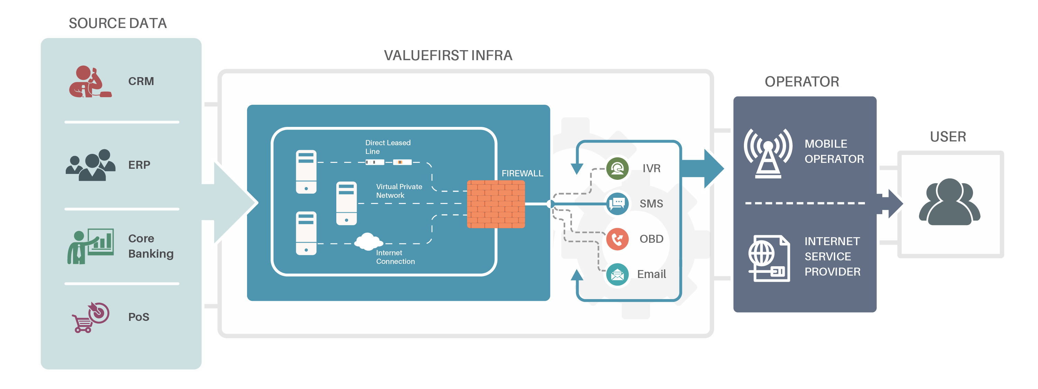
Architecture Diagram
9

Slide 10
Configuration
A voice OBD is initiated if SMS
is not delivered within X seconds
FAILED
FAILED
DELIVERED
SMS
OBD
EMAIL
USER
An email is initiated if voice OBD is not successful
10

Slide 11
Configuration
If SMS is not delivered to the user, he will
be displayed an IVR number on his device
FAILED
SMS
IVR
USER
User can call on the IVR number to hear OTP
11

Slide 12
Configuration
For critical communication, all 3 channels
can be used simultaneously to deliver the
OTP or intended communication
SENT
SENT
SENT
SMS
EMAIL
OBD
USER
Varied other configuration can be done
as required by customers
12

Slide 13
USE CASE

Slide 14
Use Case
Appointment schedule/reschedule, Test results
OTP, Password reset, Payment confirmation, Policy EMI reminders, Cheque bounce, Funds transfer, Loan approval, Renewal reminders
BFSI
Rescheduling notification, Delay information, Transaction notification
Health
Care
IT
Downtime communications, Maintenance activity
Transportation
Education
OTP, Mobile verification, Password reset, Cart abandonment, Transaction confirmation, Delivery notifications
Exam notifications, Schedule, Admit cards
E-commerce
14

Slide 15
BENEFITS

Slide 16
Benefits
Flexible channel
configuration
Integrated
reporting
Financial transaction & new customer registration will increase by 3% - 5%
No new channel Integration & zero investment on infra for any channel
Dedicated infra to ensure differentiated QoS for critical use cases
Single API integration delivers SMS/Email/Voice
16

Slide 17
Get live on
ValueFirst Digital Media Pvt.Ltd.
B-18, Infocity 1, Sector-34, Gurugram 122001, Haryana, India
Tel: +91 124 4632000
E: marketing@vfirst.com
facebook.com/ValueFirstDigital
linkedin.com/company/valuefirst-digital-media-pvt-ltd-
google.com/+VfirstDigital_media/about

